Slide 1
Week 12 Lab 1 – User accounts and Privileges
Databases Three

Slide 2
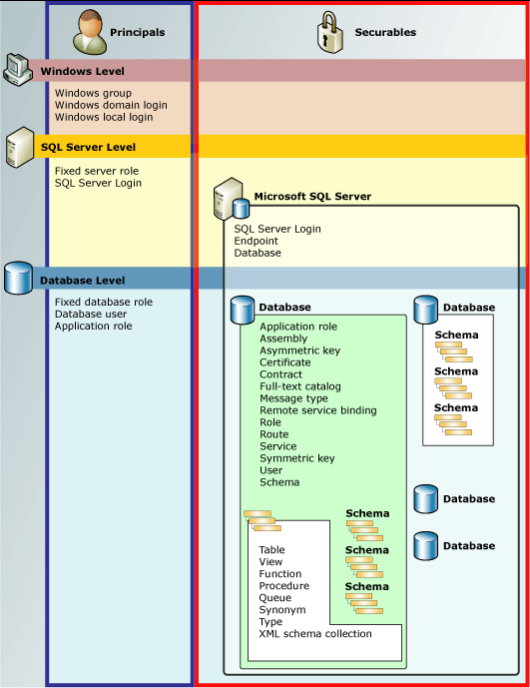
Permissions Hierarchy

Slide 3
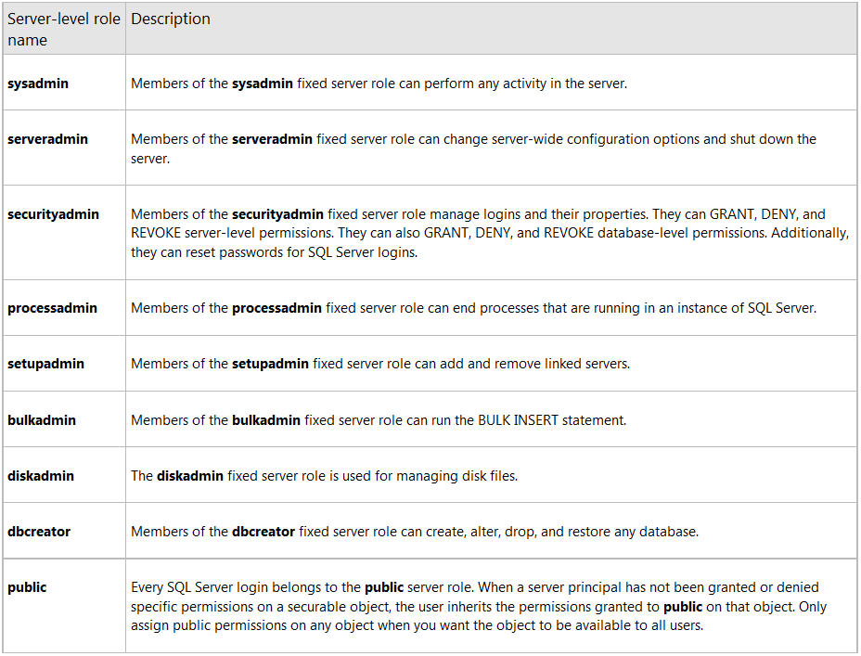
Permissions - Server

Slide 4
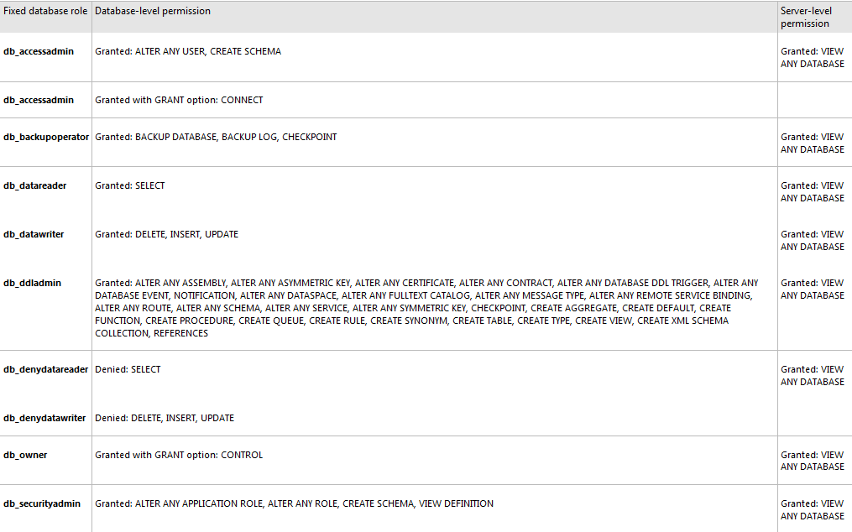
Permissions - Database

Slide 5
Security Models
Windows Authentication (local or group)
Security token is used for SQL Server user
SQL Server Authentication
A new ID and SID are created
Notes:
As we covered before a Windows authentication login is one imported from a domain. The SID is trusted by SQL Server

Slide 6
Login VS. User
Login is for SERVER
User is for DATABASE
You need both to access the database

Slide 7
Windows Authentication Code
CREATE LOGIN [user_name] FROM WINDOWS WITH
Args
DEFAULT_DATABASE=[world]
DEFAULT_LANGUAGE=[us_english]

Slide 8
Example
CREATE LOGIN [OPNET\AshleyM] FROM WINDOWS
GO

Slide 9
SQL Server Auth Code
CREATE LOGIN [user_name] WITH
Args list 1
PASSWORD = ‘password’
MUST_CHANGE
DEFAULT_DATABASE=[world]
DEFAULT_LANGUAGE=[us_english]
CHECK_EXPIRATION = ON or OFF
CHECK_POLICY = ON or OFF
If MUST_CHANGE is specified, CHECK_EXPIRATION and CHECK_POLICY
must be set to ON
Notes:
loginNameSpecifies the name of the login that is created. There are four types of logins: SQL Server logins, Windows logins, certificate-mapped logins, and asymmetric key-mapped logins. When creating logins mapped from a Windows domain account you must use the pre-Windows 2000 user logon name in the format [<domainName>\<loginName>]. You cannot use a UPN in the format loginName@DomainName. See example D later in this topic.
PASSWORD ='password'Applies to SQL Server logins only. Specifies the password for the login that is being created. You should use a strong password. For more information see Strong Passwords.
PASSWORD =hashed_passwordApplies to the HASHED keyword only. Specifies the hashed value of the password for the login that is being created.
HASHED Applies to SQL Server logins only. Specifies that the password entered after the PASSWORD argument is already hashed. If this option is not selected, the string entered as password is hashed before it is stored in the database. This option should only be used for migrating databases from one server to another. Do not use the HASHED option to create new logins.
MUST_CHANGE Applies to SQL Server logins only. If this option is included, SQL Server prompts the user for a new password the first time the new login is used.
CREDENTIAL =credential_nameThe name of a credential to be mapped to the new SQL Server login. The credential must already exist in the server. Currently this option only links the credential to a login. This option might be expanded in a future SQL Server version.
SID = sidApplies to SQL Server logins only. Specifies the GUID of the new SQL Server login. If this option is not selected, SQL Server automatically assigns a GUID.
DEFAULT_DATABASE =databaseSpecifies the default database to be assigned to the login. If this option is not included, the default database is set to master.
DEFAULT_LANGUAGE =languageSpecifies the default language to be assigned to the login. If this option is not included, the default language is set to the current default language of the server. If the default language of the server is later changed, the default language of the login remains unchanged.
CHECK_EXPIRATION = { ON | OFF }Applies to SQL Server logins only. Specifies whether password expiration policy should be enforced on this login. The default value is OFF.
CHECK_POLICY = { ON | OFF } Applies to SQL Server logins only. Specifies that the Windows password policies of the computer on which SQL Server is running should be enforced on this login. The default value is ON.
WINDOWS Specifies that the login be mapped to a Windows login.
CERTIFICATE certnameSpecifies the name of a certificate to be associated with this login. This certificate must already occur in the master database.
ASYMMETRIC KEY asym_key_nameSpecifies the name of an asymmetric key to be associated with this login. This key must already occur in the master database.

Slide 10
Example
CREATE LOGIN [AshleyM] WITH PASSWORD=‘EnterStrongPasswordHere' MUST_CHANGE,
DEFAULT_DATABASE=[World],
DEFAULT_LANGUAGE=[us_english],
CHECK_EXPIRATION=ON,
CHECK_POLICY=ON
GO

Slide 11
Alter Login
ALTER LOGIN [user_name]
ENABLE or DISABLE or NULL
WITH
PASSWORD = 'password'
OLD_PASSWORD = ‘oldpassword’
DEFAULT_DATABASE=[World],
DEFAULT_LANGUAGE=[us_english],
NAME = [new_name]
Notes:
OLD_PASSWORD ='oldpassword'Applies only to SQL Server logins. The current password of the login to which a new password will be assigned. Passwords are case-sensitive.
NAME = login_nameThe new name of the login that is being renamed. If this is a Windows login, the SID of the Windows principal corresponding to the new name must match the SID associated with the login in SQL Server. The new name of a SQL Server login cannot contain a backslash character (\).

Slide 12
Example
ALTER LOGIN [OPNET\AshleyM] ENABLE;
ALTER LOGIN [AshleyM] WITH PASSWORD = '<enterStrongPasswordHere>';
ALTER LOGIN [AshleyM] WITH NAME = [IHASCHEEZBURGER];

Slide 13
Drop (delete) Login
DROP LOGIN [user_name]
DROP LOGIN [AshleyM]
A login cannot be dropped while it is logged in

Slide 14
Checking for a login
SELECT SUSER_SID(‘login_name') will return the SID for the provided login
IF SUSER_SID(' login_name ') IS NULL
BEGIN
PRINT'There is no user'
END
ELSE
BEGIN
PRINT'There is a user'
END

Slide 15
Working with Permissions
Feature | Type | Description
sp_helpsrvrole | Metadata | Returns a list of server-level roles.
sp_helpsrvrolemember | Metadata | Returns information about the members of a server-level role.
sp_srvrolepermission | Metadata | Displays the permissions of a server-level role.
IS_SRVROLEMEMBER | Metadata | Indicates whether a SQL Server login is a member of the specified server-level role.
sys.server_role_members | Metadata | Returns one row for each member of each server-level role.
sp_addsrvrolemember | Command | Adds a login as a member of a server-level role.
sp_dropsrvrolemember | Command | Removes a SQL Server login or a Windows user or group from a server-level role.

Slide 16
Adding User FS Role
sp_addsrvrolemember [‘login_name’] , ‘[role_name]’
Where role can be the following
sysadmin
securityadmin
serveradmin
setupadmin
processadmin
diskadmin
dbcreator
Bulkadmin
Returns either zero for success or 1 for failure
SA cannot be added or removed

Slide 17
Removing User FS Role
sp_dropsrvrolemember [‘login_name’] , ‘[role_name]‘
Where role can be the following
sysadmin
securityadmin
serveradmin
setupadmin
processadmin
diskadmin
dbcreator
Bulkadmin
Returns either zero for success or 1 for failure
SA cannot be added or removed

Slide 18
Role Membership
IS_SRVROLEMEMBER (‘sysadmin')
Or for another user
IS_SRVROLEMEMBER ('sysadmin', ‘opnet\AshleyM')

Slide 19
User
CREATE USER [‘user_name’] FOR LOGIN [‘login_name’]

Slide 20
Permissions
Grant
GRANT Database Permissions
These are permissions assigned to database users at the database level
(Database properties)
Notes:
Grants permissions on a securable to a principal.
Grants permissions on a database user, database role, or application role.

Slide 21
GRANT Database Permissions
GRANT [permission]
TO
[user_name]
“WITH GRANT OPTION” to allow grant to other users
Notes:
WITH GRANT OPTION Indicates that the principal will also be given the ability to grant the specified permission to other principals.

Slide 22
Common Additional GRANTS
BACKUP DATABASE
CREATE SCHEMA
EXECUTE
SHOWPLAN

Slide 23
Example
USE AdventureWorks;
GRANT CREATE TABLE
TO [opnet\thomir];
GO
GRANT SHOWPLAN
TO [user_name];
GO

Slide 24
Revoke
REVOKE [permission]
TO
[user_name]

Slide 25
User System Views
sys.syslogins
syslogins contains one row for each valid server user account
sys.sysusers
sysusers returns all users for the database its run against

Slide 26
User Checking
SUSER_ID(‘user_name’) will return the principal
identification number
Only if the user is in the syslogins table
Takes a username in nchar format
If no username is supplied, current context is used

Slide 27
Schema
Containers to organize objects
Used for granular permissions
Default schema is dbo
AD Schema != SQL Server Schema

Slide 28
Creating A Schema
CREATE SCHEMA [schema_name]
AUTHORIZATION [owner_name]
Example
CREATE SCHEMA [Pets] AUTHORIZATION [dbo]
AUTHORIZATION Is the database level principal who will own the schema

Slide 29
Dropping A Schema
You can drop a schema
Must not contain any objects

Slide 30
Granting Permissions
Odd syntax
GRANT [permission]
ON SCHEMA::[schema_name]
TO [user_name]
Example
GRANT SELECT ON SCHEMA::[Development] TO [MrCrabs]
GRANT EXECUTE ON SCHEMA::[Development] TO [SpongeBob]

Slide 31
Principals
Schema permissions can be applied to:
database user
database role
application role

Slide 32
Grantable Schema Permissions
Alter
Control
Delete
Execute
Insert
References
Select
Take Ownership
Update
View change tracking
View definition

